Slide 1

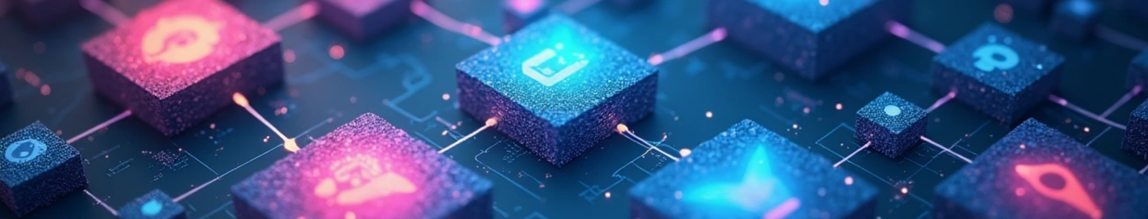
Proposal for Junior Design Project – Image Classification and Identification
Date: 2025.06.04

Slide 2


CONTENTS
1. Introduction
2. Objective
3. Scope of Work
4. Technologies and Tools
5. Key Machine Learning Concepts
6. Expected Outcomes
7. Conclusion

Slide 3

01
Introduction

Slide 4

Introduction
North South University
CSE299: Junior Design
Project Title: Image Classification and Identification
Course Instructor: Mohammad Shifat-E-Rabbi
Section: 5
Group Members:
Name | ID
Noshin Nawar | 2221507042
Md. Arebi Sarker | 2221362042
Mubashshira Kaisar | 2221070642
Md Zidan Khan | 2231413642

Slide 5

02
Objective

Slide 6


Objective
The primary goal of this project is to develop efficient and accurate image classification models using Python and relevant ML frameworks.
These models will recognize and distinguish key visual features in different image types, enabling practical applications in areas such as veterinary care, handwriting analysis, security, transportation, and healthcare.

Slide 7

03
Scope of Work

Slide 8



Scope of Work
1
Image Classification
2
Image Segmentation
• Assign a label to each pixel in an image to distinguish different objects or regions.
• Helps to understand the structure and layout within images.
• Includes different kinds of image classification task.
• Use datasets apply models like CNNs, MobileNet, or ResNet for accurate predictions.
3
Object Detection
4
Object Size Estimation
• Detect objects such as faces, vehicles, planes, trains, etc., by drawing bounding boxes.
• Use detection models like YOLO, SSD, or Haar Cascades and DNN models for real-time applications.
• Measure objects in images using a known reference (e.g., coin, A4 paper).
• Convert pixel distances to real-world dimensions (cm/inch) using scaling techniques.
5
Handwritten Digit Recognition
• Recognize handwritten digits (0–9) and letters (A–Z).
• Use MNIST and EMNIST datasets with deep learning models.
6
Document Scanner
• Detect document corners and apply perspective transformation.
• Create scanned versions from raw images using OpenCV.

Slide 9
Scope of Work
7
OMR Test Grader
8
Ball Tracker
• Detect and track the motion of a ball in a video.
• Apply object detection and contour tracking for dynamic analysis.
• Identify filled bubbles in OMR sheets and compare with answer keys.
• Automate test grading using contour and threshold analysis.
9
Drowsiness Detection
10
Bone Fracture Detection
• Detect fractures in X-ray images using CNN models.
• Employ datasets like MURA for medical image diagnosis.
• Monitor eye aspect ratio to detect signs of drowsiness.
• Raise alerts when the subject appears to be falling asleep.
9
Pet Classification
10
Age Classification
• Binary classification of pets using the Kaggle dataset.
• Use simple CNN or MobileNet for prediction.
• Classify pets as kitten/puppy, adult, or senior based on image features.
• Useful for veterinary applications.
11
Traffic Sign Recognition
12
Fracture Detection
• Recognize road signs using the GTSRB dataset.
• Apply classification with region-based CNNs for real-time use.
• Detect fractures in X-ray images using CNN models.
• Employ datasets like MURA for medical image diagnosis.

Slide 10

04
Technologies and Tools

Slide 11


Technologies and Tools
Programming Language: Python
Frameworks/Libraries:
• TensorFlow / Keras
• OpenCV
• NumPy / Pandas
• Matplotlib / Seaborn

Slide 12

05
Key Machine Learning Concepts

Slide 13

Key Machine Learning Concepts
1
Convolutional Neural Networks
2
Data Preprocessing
Neural Networks (CNNs)
resizing, normalization, augmentation
3
Evaluation Metrics
4
Overfitting Control
accuracy, confusion matrix
dropout, regularization
5
Transfer Learning
VGG16, MobileNet, etc.

Slide 14

06
Expected Outcomes

Slide 15



Expected Outcomes
Problem Domain Models
Visual Outputs
Final Report Summary
Successfully working models for each problem domain.
Visual outputs showing detections, classifications, or predictions.
A final report summarizing:
• Methodologies
• Dataset challenges
• Results and accuracy metrics
• Improvement opportunities

Slide 16

07
Conclusion

Slide 17

Conclusion
This project will help us strengthen our understanding of machine learning, image processing, and their application in solving practical problems. We look forward to receiving your valuable feedback and approval.
Department of Electrical and Computer Engineering
North South University
4th June, 2025

Slide 18
Thank You

